Slide 1
TEAM
SKAGGLERS
Multiclass Text classification

Slide 2

Problem we are solving
Classify consumer complaints into predefined categories.
Given a consumer problem our goal is to classify any new complaints into one of the predefined categories.

Slide 3


TEAM MEMBERS
Subham Banerjee
Sayan Saha
Sakalya Mitra
Satyaki Bhattacharjee

Slide 4
Why text classification is important?
Customer complaints is a big problem as customers post their queries and we need an automated method to classify the complaints or queries into predefined categories. Thats why an efficient ML model would be really helpful tp classify the problems.

Slide 5
Our Solution!!!!
Text Classification using Classification algorithms: Linear Support Vector Machine (LinearSVM), Random Forest, Multinomial Naive Bayes and Logistic Regression.

Slide 6
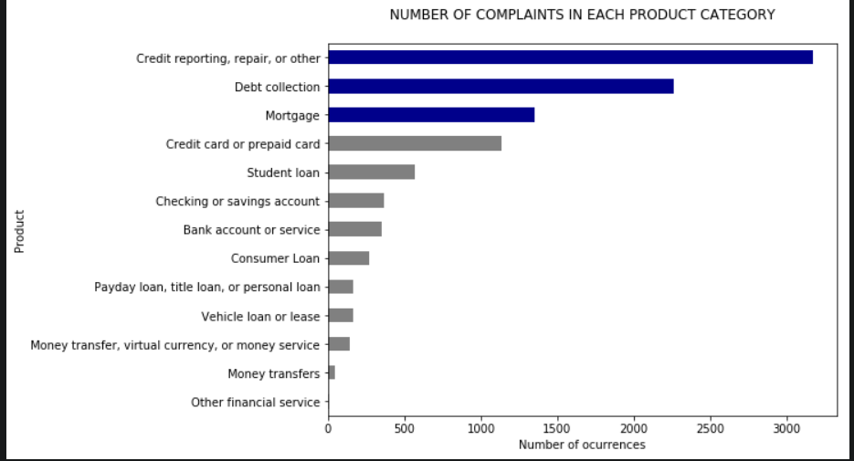

As we can see the most number of complaints are in the category of Credit Reporting. So we have given more importance to this category.

Slide 7

TFIDF
It is an important concept as it measures how often a word appears in a text and hence weightedly classifies it when a new text appears.

Slide 8
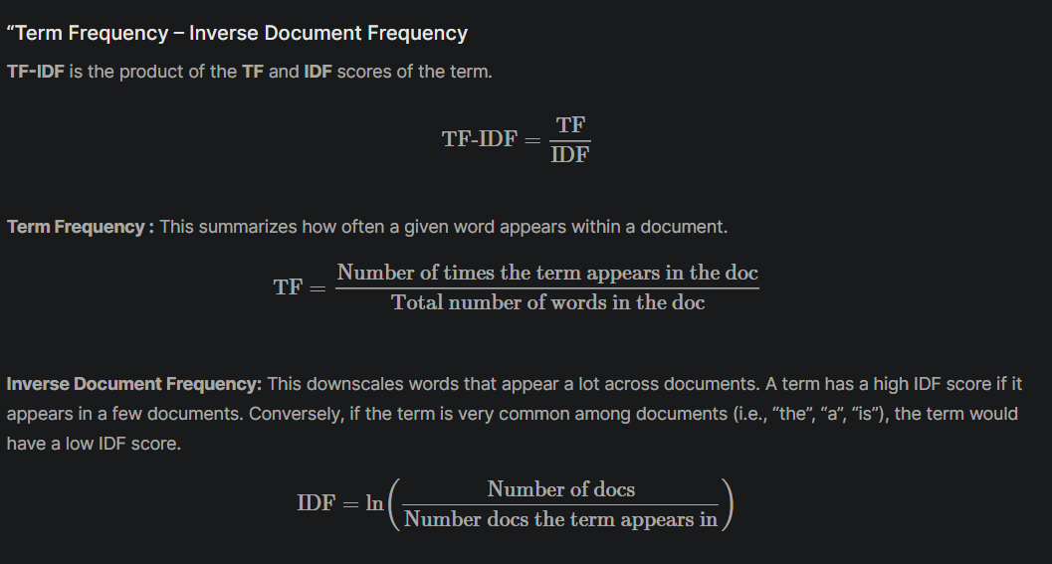

Slide 9

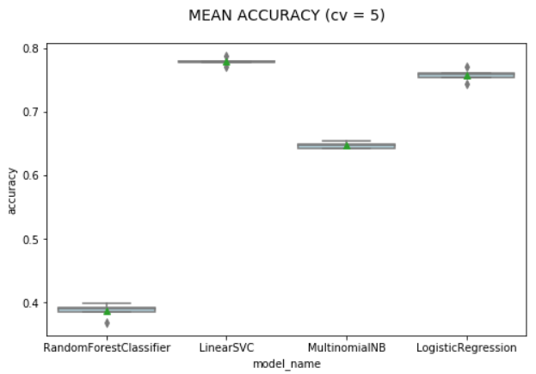
How we selected the best model?
We plotted the accuracies of different classification algorithms and compared the best to come up with the most optimal solution.

